Slide 1
IDHAYA COLLEGE FOR WOMEN , SARUGANI.
FRESH BITES CATERING
Team Members:
N.Hamema shahin
A.Deepika
G.Deepthi
S.Deva Bharathi

Slide 2
INTRODUCTION:
Overview:
Zohobooks is an online accounting application that take care of the accounting of your business. You can record audit and analysis all financial transaction easily.
Purpose:
Zohobooks helps them maintain accurate financial records and streamline their catering operation.

Slide 3
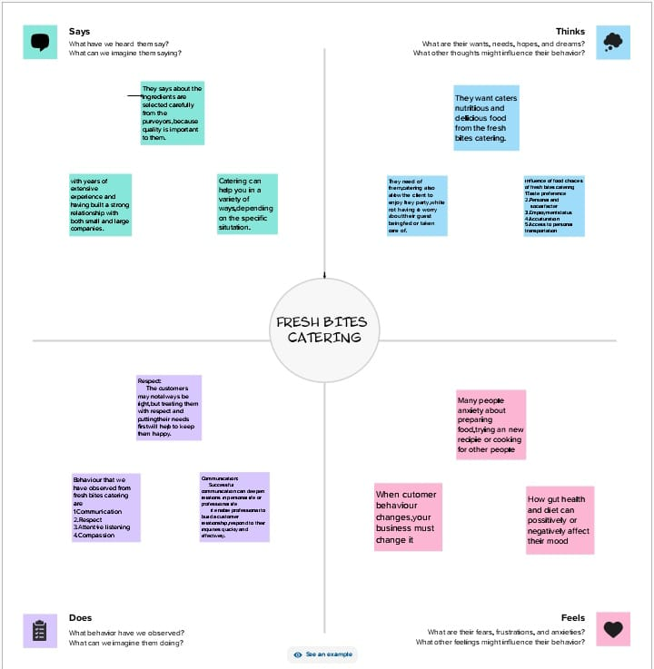
Empathy Map:

Slide 4
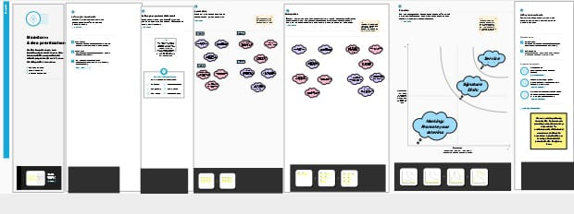
Brainstorming Map:

Slide 5
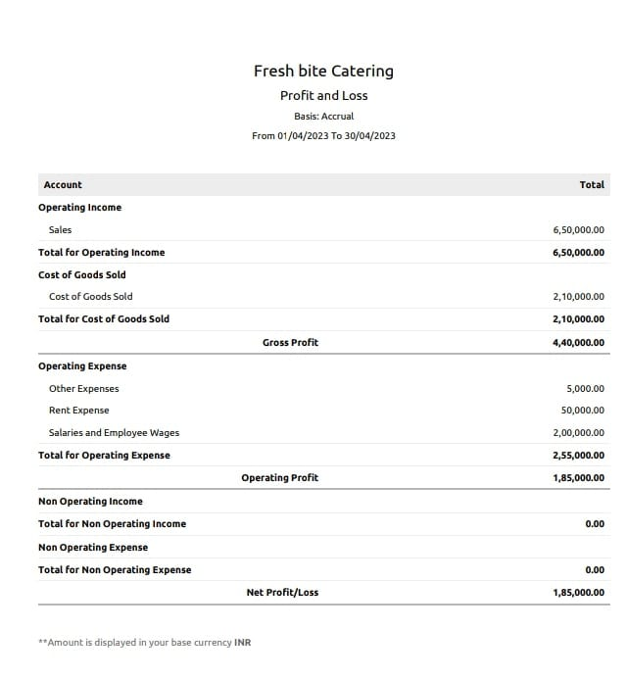
Profit and Loss Account:

Slide 6
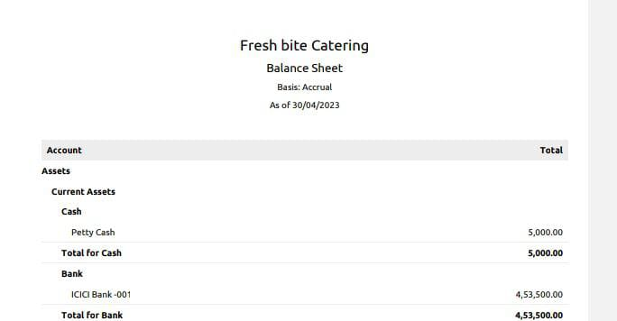
Balance Sheet:

Slide 7
Advantages and Disadvantages:
Advantages: Disadvantages:
Online Payments Additional users require a fee
Minimizes dates last Accrued payable limitation
Reduce overall cost No payroll services
Reports generation Multiple subscription
Expense Tracking High cost

Slide 8
Application:
Zohobook is your one stop platform for managing accounting task and organising transactions. Single resource location to keep up with your company bills and invoices

Slide 9
Conclusion
Zohobooks give you one integrated system to transform your businesses disperate activities into amore connected and agile system.

Slide 10
Future scope:
United Customer
Global expansion plans
Focus on cloud services
Premises offering

